Slide 1
Innovation for AAL
Final presentation
Notes:
Juan

Slide 2




Meet our Team
Luis Alarcon CSCE 22’
Santana Gonzales
ITDE 23’
Juan Perez
ISEN 21’
Mualla Argin
CPSC 23’
Notes:
Juan

Slide 3


Slide 4

Problem Statement
There is no agreed-upon way to determine if innovation
activities are creating real value for the DoD/Army.
Basket of metrics that reflect potential success of AAL’s companies
Tool to monitor these metrics
Notes:
Juan

Slide 5

Business Thesis
Our team will identify KPIs that the Army Applications Lab can use to evaluate the success of innovation projects
Notes:
Juan

Slide 6

Hypothesis
Assumptions:
AAL would have reliable and enough data to create KPIs
AAL would collect the same data for every project
AAL project managers can tell their customers what to do and how to do it
Approach:
Clean AAL’s data
Create KPIs from data
Present it with a dashboard
Notes:
juan

Slide 7



Customer Interviews
Industry
Industry norms
Tangible milestones
Speak with more PMs
Assess Tech. Readiness Levels (TRLs)
Research
TRL Assessment and stages
Build a Framework
Army Applications Lab
Current recorded data
Complexity of Project types
Cohesion amongst PMs
Push for future metrics
Notes:
Santana

Slide 8

Final Approach
Give AAL the necessary methods to gather the right data
Train their employees and project managers to use the tools and methods we create
Track the metrics and score projects congruently
Notes:
Santana

Slide 9
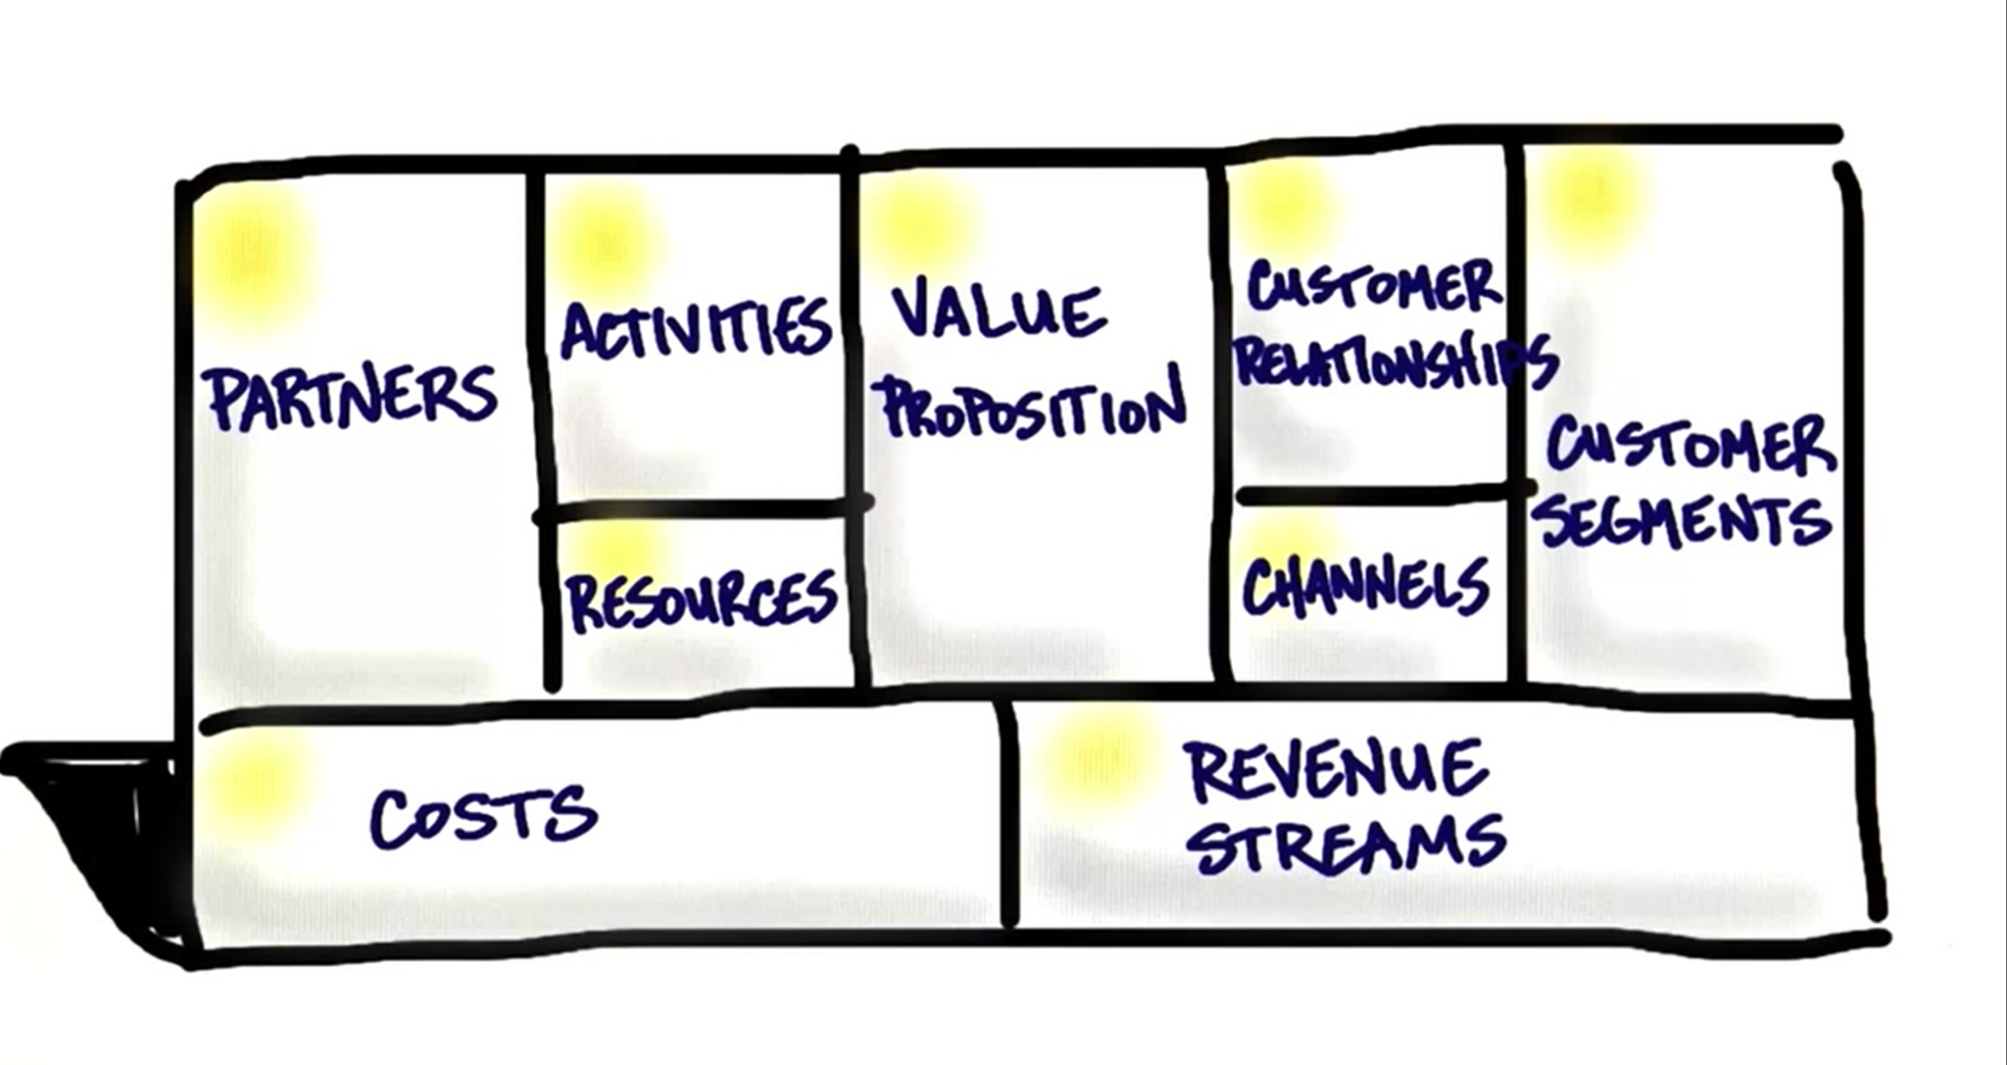
Mission Model Canvas
Notes:
Luis

Slide 10
Partners Army Applications Laboratory | Activities Get feedback from AAL | Value Proposition Measure the potential success of their ongoing innovation projects. We will help AAL make better decisions based on data gathered pre, during and post project. | Customer Relationships Free trials Constant updates Referral Programs | Customer Segments Business that are invested in research and development projects
 | Resources Finance: Cloud Storage for Data Intellectual: AAL dataset and case study Human: Software Engineers |  | Channels Physical Channels: Word of mouth Tech Conferences Online Channels: Email Website
Costs Initial cost Cost of hiring developers Cost of hiring UI Designers Yearly Maintenance Hosting dashboard Cost of cloud service |  |  | Revenue Streams Subscription Based Monthly Yearly
Notes:
Luis

Slide 11
Innovation Framework
Standardization
Quantitative
Analysis
Standardization
Qualitative Tracking
Our 3 steps to track and measure the success of innovation within your organization
Data Evaluation
Notes:
Luis

Slide 12

Standardization
Implementation policies that will apply to the entirety of the Program Managers to aide in the cohesion and team analysis of projects across the board.
Initial trainings for software and check ups to ensure cohesion
Require microsoft project from every company on all contracts
Use the same metrics/scoring system across all projects
Notes:
Luis

Slide 13
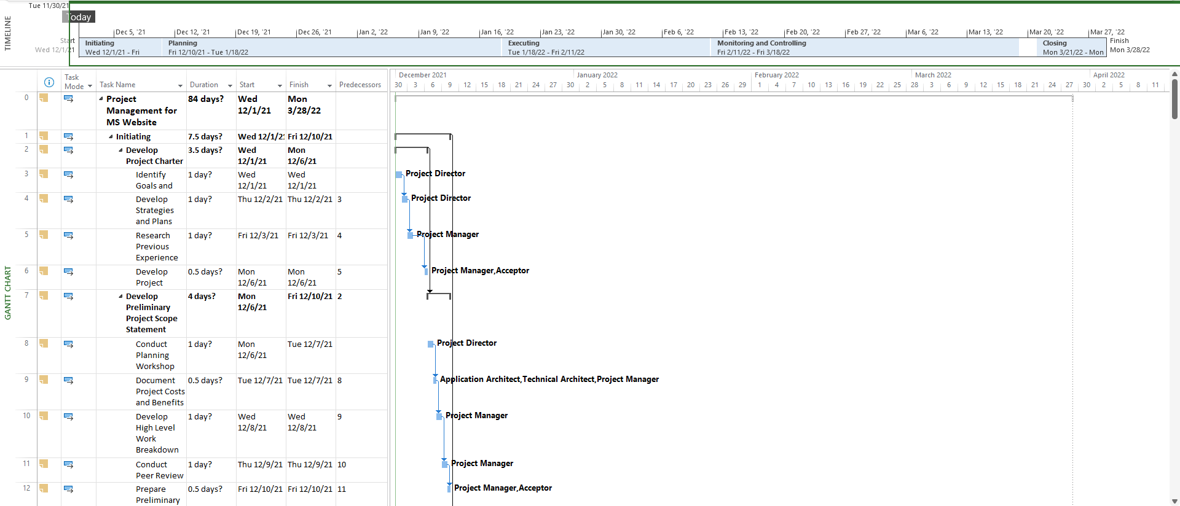
Notes:
Luis

Slide 14

2. Quantitative Tracking
To accurately measure each project, we have created a success monitoring tool that each manager should use on each project.
Touch points
Investments
Milestones
etc.
Notes:
Santana

Slide 15
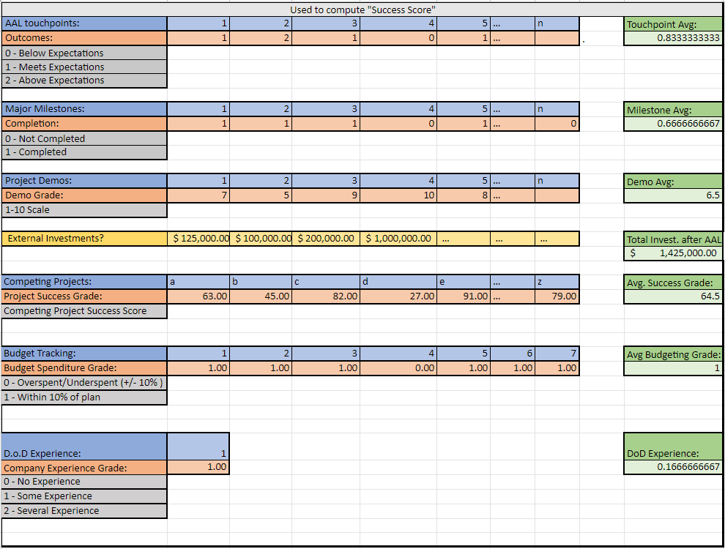
Notes:
Santana

Slide 16

3. Data Evaluation
Direct measurement of the quantitative success tool.
Simple dashboard:
Running total of the projects process
Shows past project success scores
Project success scores can be linked to companies to see company performance over time.
Notes:
Santana

Slide 17
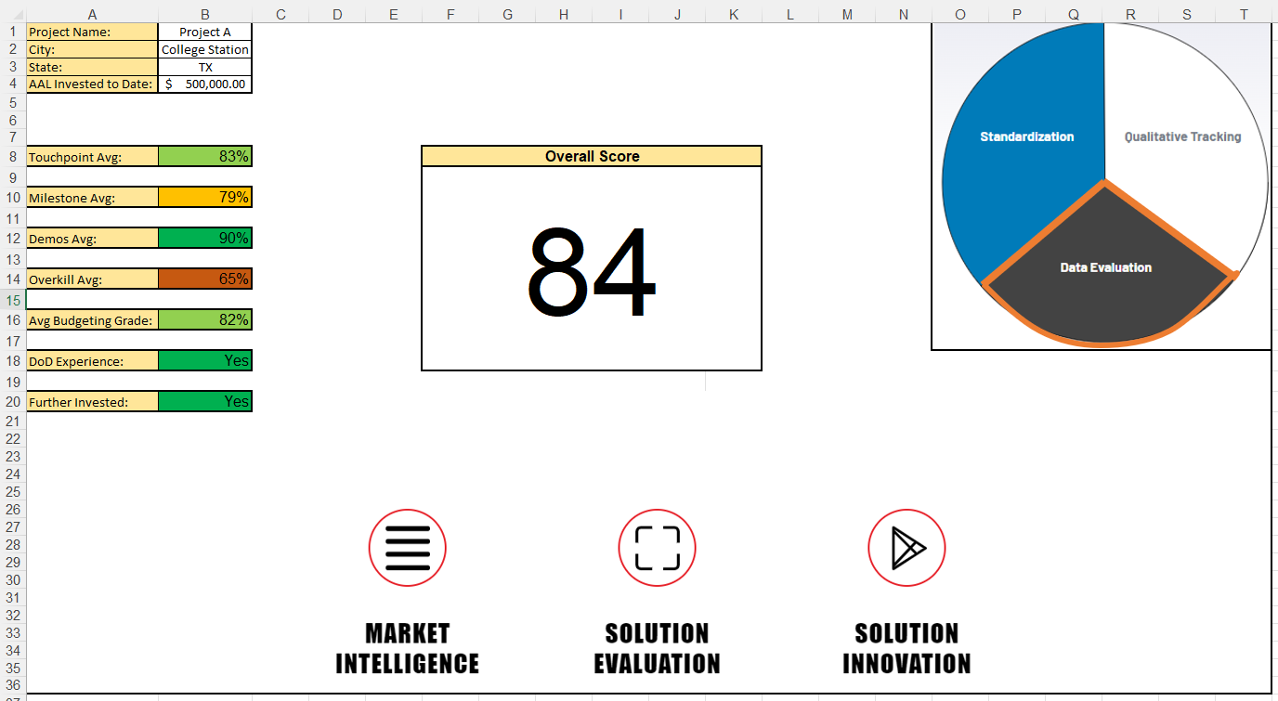
Notes:
Santana

Slide 18

Competition
Consultants
Selling processes to a company with the promise of improving their business
Project Management Tools
Offers an incomplete solution to R&D entities
Notes:
Mualla

Slide 19

Market Size
TAM
Total Addressable Market (TAM)
Startups
Serviceable Available Market (SAM)
R & D startups
Serviceable Obtainable Market (SOM)
Internal Army Organizations
SAM
SOM
Notes:
Mualla
Total Addressable Market TAM (the whole potential market)
Startups like clubhouse can benefit from our innovation metrics dashboard
Serviceable Available Market SAM (reachable market)
Coritech Services (electrical control systems debugging)
Czero (mechanical engineering firm)
Fermata Energy (accelerates adoption of EV)
Serviceable Obtainable Market SOM (local, target market)
Army Organizations like the Army Applications Laboratory

Slide 20

Dual Use
Commercial Use:
Incubators
Academic Institutions
Venture Capital Firms
Non-Profits
D.o.D. Use:
DevCom - Army Research Laboratory
Army Applications Laboratory
Projects onboarded in the future
Notes:
Mualla

Slide 21

Lessons Learned
Soft Skills:
Presentation skills
Technical Communication skills
Hard Skills:
Lean Launch Methodology
Mission model canvas
Pivoting
Product research
Customer discovery
Notes:
Mualla

Slide 22

Next Steps:
AAL
Follow up to implement this framework to their ops
Research
Look up how to integrate TRLs into the tool
Tool Improvements
Improve dashboard graphics
Update weighting system for the metrics
Notes:
Mualla

Slide 23
Questions?
Notes:
Mualla

Slide 24
References:
https://aal.army/
https://aal.army/what-we-do/
https://aal.army/our-team/
Research Articles:
https://www.mckinsey.com/business-functions/strategy-and-corporate-finance/our-insights/how-to-take-the-measure-of-innovation
https://venturewell.org/venture-development-framework/
https://scholarworks.alaska.edu/handle/11122/5635
https://www.sbir.gov/sites/default/files/1_outreach-ipc_report.pdf
https://api.army.mil/e2/c/downloads/404585.pdf
https://techlinkcenter.org/news/technology-readiness-level-dod/
http://citeseerx.ist.psu.edu/viewdoc/download?doi=10.1.1.562.3338&rep=rep1&type=pdf
https://web.p.ebscohost.com/ehost/pdfviewer/pdfviewer?vid=1&sid=733765cb-c6f3-41fa-a84e-183770ded929%40redis
https://ieeexplore.ieee.org/abstract/document/5747634?casa_token=Edk3oouYmDQAAAAA:3IYlZpDAiK2bQm-MwLGd7m0TD-HKSncHVqSVcO8DEPfRac2MJbj0GquqcA32k3PVcuL2r4lJFA

